Slide 1

Flotilla 20-10
Swansboro, North Carolina

Slide 2
Who we are
The U.S. Coast Guard Auxiliary is the uniformed volunteer component of the United States Coast Guard created by an Act of Congress in 1939. The Auxiliary, America's Volunteer Guardians, supports the Coast Guard in nearly all of the service's missions.

Slide 3
What do we do?
Conduct Vessel Safety Checks, free examinations available to any recreational boater, that help boaters ensure their craft complies with boating regulations.
Conduct marine safety patrols
Distribute boating regulations and safety information.
Teach boating safety classes to recreational boaters of all ages.
Stand communication watches, assist during mobilization exercises and recruit new people for the Service.
Participate in Coast Guard Search and Rescue missions.
Operate safety and regatta patrols.
Are prohibited from performing law enforcement tasks

Slide 4
Why we volunteer
Service to our community
Training that make us better boaters
Fellowship that results from working with like minded citizens

Slide 5
Qualifications to Join
To join, one must be 17 years or older and be a U.S. citizen.
Each applicant must complete a personal security investigation form and other paperwork, and get a photo taken. Applicants will also need a copy of their passport or birth certificate and driver’s license to include in their enrollment packet. The auxiliary will have a staff member assist in assembling your application packet.

Slide 6
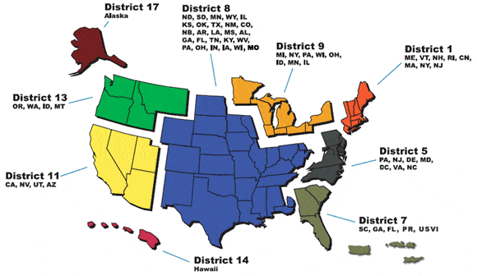
Where we are in the Coast Guard
( Fifth District)
We are Flotilla 10 in Division 20, part of Coast Guard Auxiliary District 5.
Division 20(Central Carolina Coast) consists of flotillas
01 – New River
02 – Morehead City
03 - Oriental
04 – New Bern
06 – Washington, NC
10 - Swansboro, NC

Slide 7
Auxiliary Structure
Although under the authority of the Commandant of the U.S. Coast Guard, the Auxiliary is internally autonomous, with locally elected officers, operating on four organizational levels: Flotilla, Division, District/Regions and National.
.

Slide 8
Flotilla
The Flotilla is the basic organizational unit of the Auxiliary and is comprised of at least 15 qualified members who carry out Auxiliary program activities. Every Auxiliarist is a member of a local Flotilla. Each Flotilla is headed by a locally elected Flotilla Commander, (FC). The FC is assisted by a vice flotilla commander and appointed staff officers, (FSO), who have various staff responsibilities.

Slide 9
Other levels of structure
Divisions Flotillas in the same general geographic area are grouped into Divisions. The Division provides administrative, training and supervisory support to Flotillas and promotes District policy. Each Division is headed by a Division Commander and Division Vice Commander and usually consists of five or more Flotillas.
Districts Flotillas and Divisions are organized in Districts comparable to the Coast Guard Districts. Some Districts are further divided into Regions. The District/Region provides administrative and supervisory support to Divisions, promotes policies of both the District Commander and National Auxiliary Committee. At this level, Coast Guard officers are assigned to oversee and promote the Auxiliary programs.
National The Auxiliary has national officers who are responsible, along with the Commandant, for the administration and policy-making for the entire Auxiliary. These officers comprise the National Executive Committee (NEXCOM) that is composed of the Chief Director of Auxiliary (an Active Duty officer), National Commodore and the National Vice Commodores

Slide 10
Flotilla Area of Responsibility
(Supporting CG Station Emerald Isle)
Coast Guard Station Emerald Isle is a small boat station, located at the tip of the western end of Emerald Isle, NC. The Station's area of responsibility encompasses approximately 50 nautical miles of the Atlantic Intracoastal Waterway (including Bogue Inlet, New River Inlet, White Oak River, New River and Stump Sound down to Surf City, NC) from ICW buoy 21 in Bogue Sound to buoy 71 in Stump Sound and up to 30 nautical miles offshore. The 20-10 flotilla area of responsibility is the same, except it ends on the western end at New River (marker 2, Stump Sound). Land operations, mostly vessel safety checks and classes, generally support boaters in Emerald Isle, Swansboro and surrounding communities

Slide 11
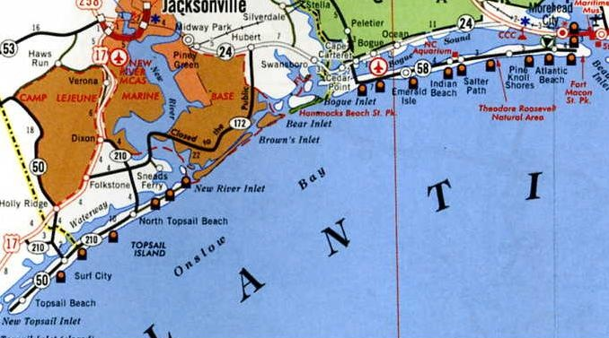
Coast Guard Station EI
Area of Operations
21
21 Bogue Sound
CG Sta Em. Isle
71
71 Stump Sound

Slide 12
When we work
Depending on activities selected to participate in ( chef, instructor, vessel examiner, patrol member, etc), volunteers work throughout the month at times that fit their schedule.
Flotilla meetings occur the second Tuesday of each month at the Western Carteret Community Center, 275 Old Highway 58, Cedar Point, NC 28584, at 7 PM

Slide 13
Flotilla overview 2024 data
Flotilla 20-10 has 28 members
4 boats are rated as USCG “facilities”
10 members are rated as vessel examiners
6 are rated as instructors
2 are rated as boat crew members
5 are rated boat coxswains
3 are rated as chefs
1 is a rated commercial fishing vessel examiner
5 are rated recreational boating safety visitors

Slide 14
Flotilla Command and Staff 2025
Commander –Don Thompson Vice Commander –Pam Carriker
MEMBER TRAINING (FSO-MT) Glenn Baxter
Navigation Services (FSO_NS) Glenn Baxter
PUBLIC EDUCATION (FSO-PE) Don Thompson
OPERATIONS (FSO-OP) Chuck Petersen
VESSEL EXAMINER (FSO-VE) Carl Rauschenberg
PUBLIC AFFAIRS (FSO-PA) Carl Rauschenberg
NEWSLETTER (FSO-PB) Vacant
HUMAN RESOURCES (FSO-HR) Fred Jelinek
FINANCE (FSO-FN) Fred Jelinek
COMMUNICATION SERVICES (FSO-CS) Fred Jelinek
INFORMATION SERVICES (FSO-IS) Vince Starace
MATERIALS (FSO-MA) Vince Starace
PROGRAM VISITOR (FSO-PV) Pat Curley
SECRETARY/RECORDS (FSO-SR) Pam Carriker

Slide 15
MEMBER TRAINING (FSO-MT)
Responsible for administering all training of flotilla members. This includes boat crew, instructor, and vessel examiner training. Conducting all required Operations, Instructor, and Vessel Examiner Workshops is another FSO-MT responsibility. For these, the FSO-MT must coordinate with the Operations, Public Education, and Vessel Examiner Staff Officers.

Slide 16
PUBLIC EDUCATION (FSO-PE)
Responsible for administering and scheduling public education courses. Such work includes getting class space, instructors, and course materials. The FSO-PE must work with the FSO-MT to ensure properly trained instructors are available for the flotilla. This staff officer also coordinates with the Public Affairs Staff Officer (FSO-PA) for advanced publicity for the public education courses.

Slide 17
OPERATIONS (FSO-OP)
The Operations Staff Officer is responsible for getting facilities and crews to meet the patrol activity requested by the Coast Guard. The FSO-OP must also work with the FSO-MT to be sure properly trained members are available to conduct the desired patrols.

Slide 18
COMMUNICATIONS (FSO-CM)
This officer is primarily concerned with Auxiliary fixed land and land mobile radio facilities. The duties include the annual inspection of these facilities and their proper operation. The FSO-CM works with the FSO-MT to have the Communication Specialty Course (AUXCOM) taught to those desiring to participate in Auxiliary communications.

Slide 19
VESSEL EXAMINER (FSO-VE)
Responsible for administering the Vessel Examiner (VE) Program. This effort includes scheduling Vessel Safety Checks (VSC) stations, particularly during VSC month. The FSO-VE works with the FSO-MT to be sure that properly trained Vessel Examiners are available for the flotilla. The FSO-VE coordinates with the Public Affairs Staff Officer (FSO-PA) for advance publicity about the VE Program and the VSC station schedule. The FSO-VE aids the FSO-OP to have all vessel facilities inspected before the district facility inspection deadline.

Slide 20
PERSONNEL SERVICES (FSO-PS)
This officer has two goals: (1) to recruit, and (2) to retain members. The FSO-PS works primarily with the FSO-PE and FSO-VE to recruit new members for the flotilla. The PE and VE Programs offer the most exposure of the flotilla to the boating public. The Instructors and Vessel Examiners are the prime recruiters for new members. The FSO-MT is a key player in the retention efforts of the flotilla.

Slide 21
PUBLIC AFFAIRS (FSO-PA)
This staff officer works in cooperation with other staff officers to get maximum local publicity on flotilla activities.

Slide 22
Human Resources (FSO-HR)
The Human Resources Staff Officer has two goals: (1) to recruit, and (2) to retain members. The FSO-HR works primarily with the Public Education and Vessel Examiner Staff Officers to recruit new members for the flotilla. The Public Education and Vessel Safety Check Programs offer the most exposure of the flotilla to the boating public. The Instructors and Vessel Examiners are the prime recruiters for new members. The FSO-HR depends on these members for flotilla growth. The Member Training Staff Officer is a key player in the retention efforts of the flotilla. Members expect training and involvement. If training is not done, the flotilla will lose members.

Slide 23
FINANCE (FSO-FN)
The Flotilla Finance Staff Officer is the bookkeeper of the flotilla’s finances. The FSO-FN collects members’ dues and PE book sale funds, and maintains the flotilla’s checking account. The FSO-FN must promptly pay all bills for Auxiliary dues and other obligations. This staff officer is responsible for preparing an annual budget and for submitting monthly financial statements.

Slide 24
COMMUNICATION SERVICES (FSO-CS)
This officer promotes development and support of the unit's eTechnology resources. This includes support of the unit website, monitoring applicable email communications and relaying them to members without email capabilities, as well as ensuring that Public Education course schedules are maintained on the appropriate websites, assisting the FSO-PS, FSO-MT and members with web based resources, PowerPoint, and other technologies.

Slide 25
INFORMATION SERVICES (FSO-IS)
While the FSO-FN is the monetary bookkeeper of the flotilla, the FSO-IS provides data bookkeeping of all flotilla activity data. The FSO-IS is a key player in monitoring AUXDATA and AUXINFO SYSTEMS for the flotilla.

Slide 26
MATERIALS (FSO-MA)
The Auxiliary Association Inc. (CGAUXA, Inc) operates the Auxiliary Center (AUXCEN), and the Coast Guard operates the Auxiliary National Supply Center (ANSC). The FSO-MA, if designated by the Flotilla Commander, orders items from ANSC, such as stationery and Coast Guard training publications that are provided by the Coast Guard. The FSO-MA also assists members in purchasing items from the AUXCEN through the District Materials Center, operated by the DSO-MA.

Slide 27
Navigation Services (FSO-NS)
The FSO-NS Officer oversees the flotilla’s Chart Updating (CU) and Aids to Navigation (ATON) efforts. The job includes checking Private Aids to Navigation (PATONs). For this last effort, the flotilla must have enough qualified Aids Verifiers (AV). Many flotillas also appoint the FSO-NS as the Aids Verifier Examiner (AVE). The AVE qualifies potential Aids Verifiers.

Slide 28
Program Visitor (FSO-PV)
The Program Visitor provides boating safety information to marine dealers. Auxiliarists visit specific dealers on a regular basis and supply them with information and Auxiliary public material regarding boating safety, Auxiliary public education courses, and Vessel Safety Checks.

Slide 29
SECRETARY/RECORDS (FSO-SR)
The FSO-SR prepares and distributes the minutes of all flotilla meetings. The Flotilla Commander may assign other flotilla records for the FSO-SR to maintain, such as rosters and standing rules.

